Slide 1

Defense Line
How to stop another pandemic.

Slide 2
What is the problem?
Difficulty in recording and transferring patient information securely in high-risk areas.
Lack of robust equipment to monitor vital signs in challenging environments.
Challenges in maintaining communication between patients and families.
Inefficiencies in contact tracing and monitoring exposed individuals.
Ensuring healthcare worker safety and efficiency in high-risk zones.

Slide 3
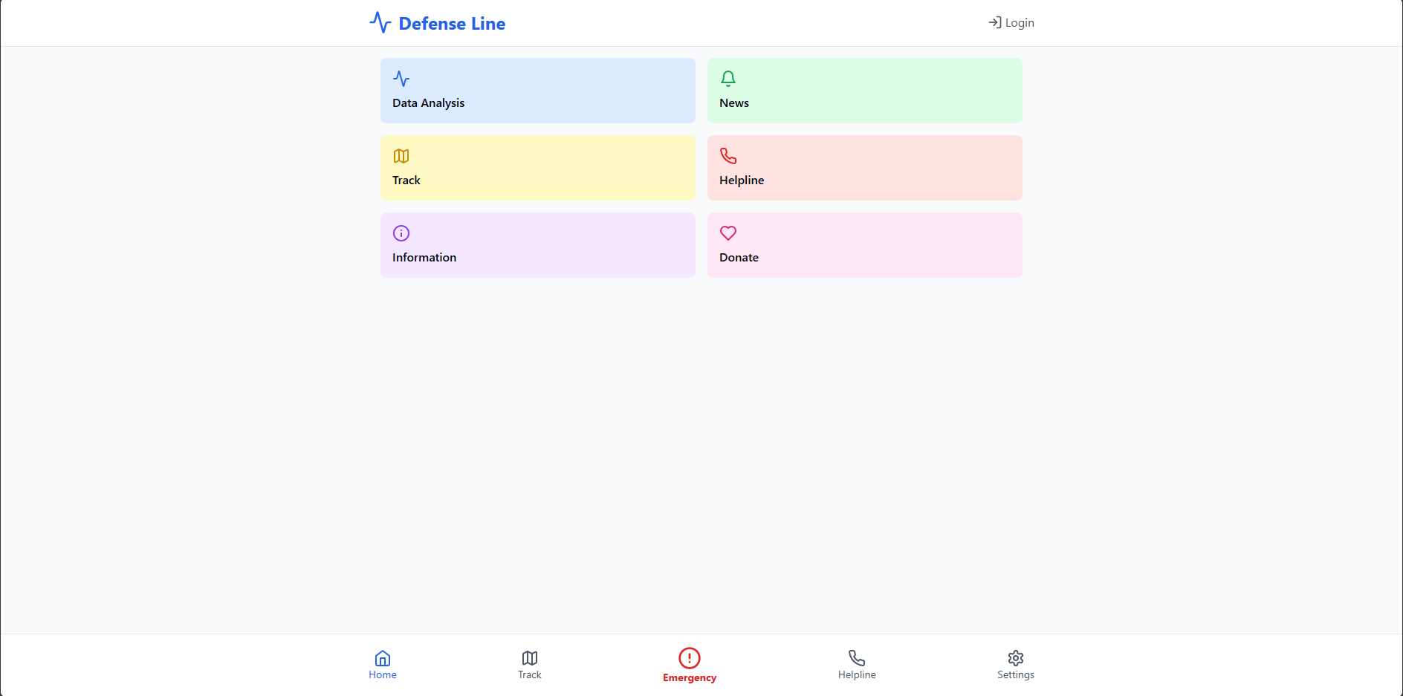
How does this app fix that?

Slide 4
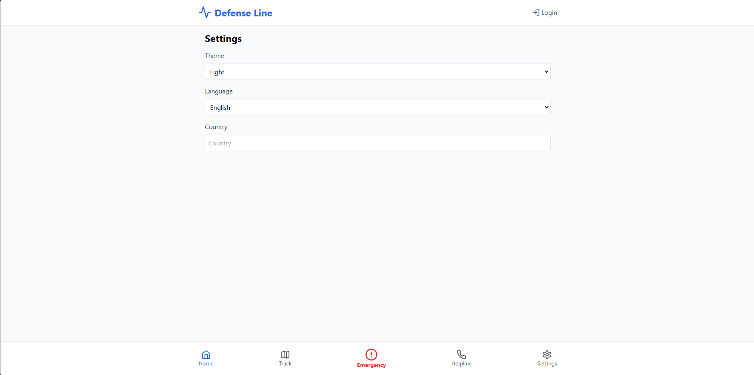

Slide 5
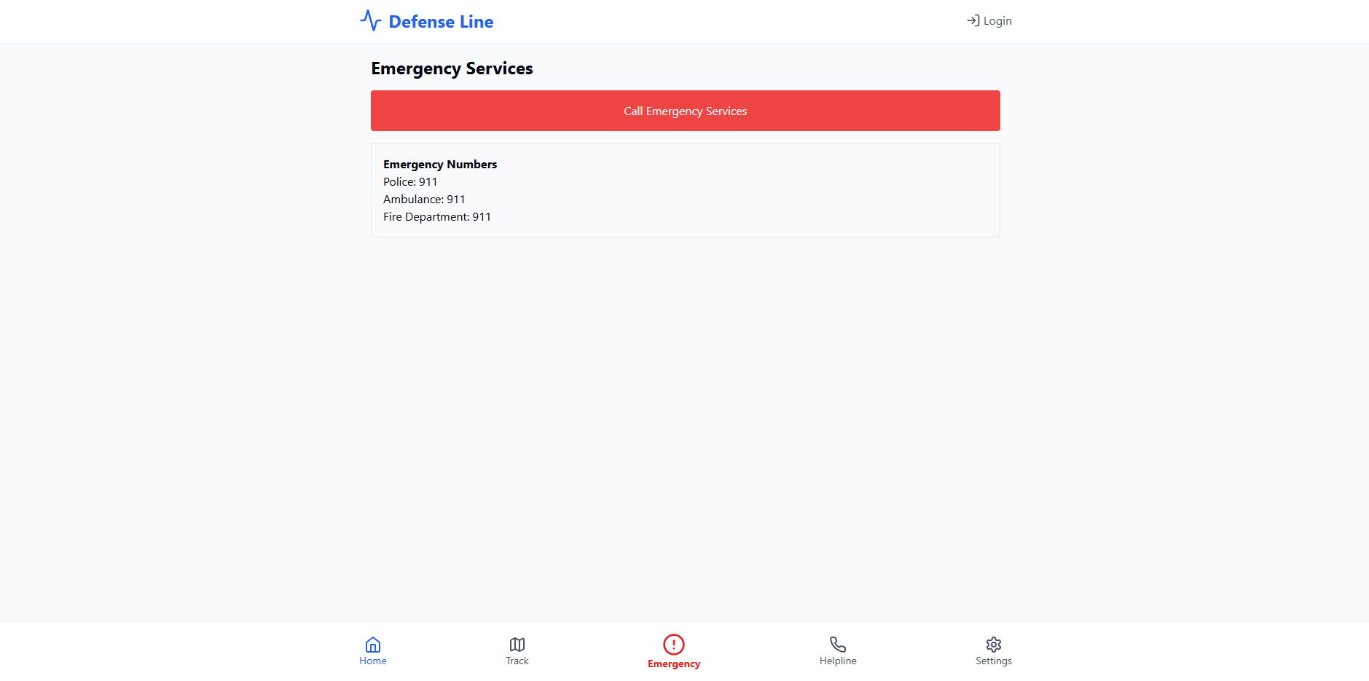

Slide 6
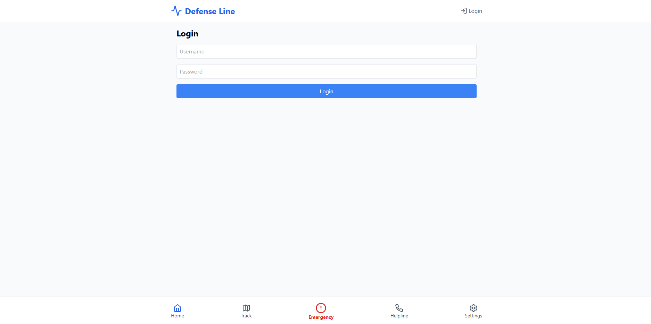

Slide 7
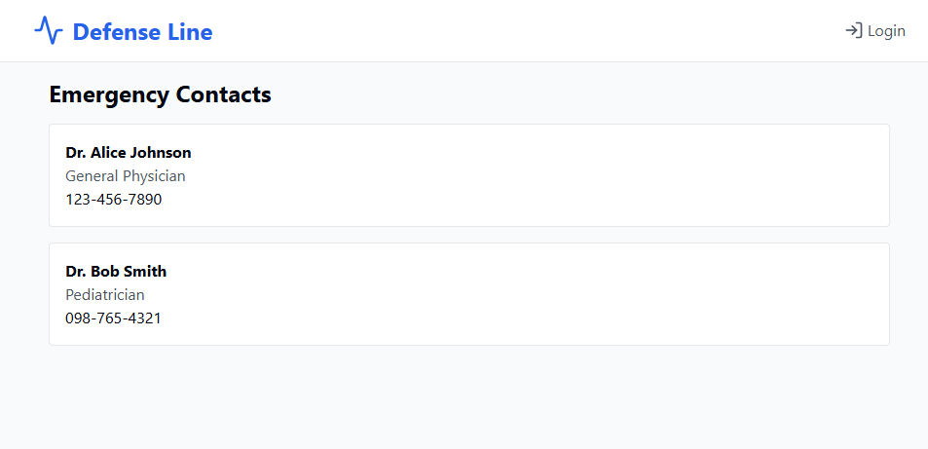
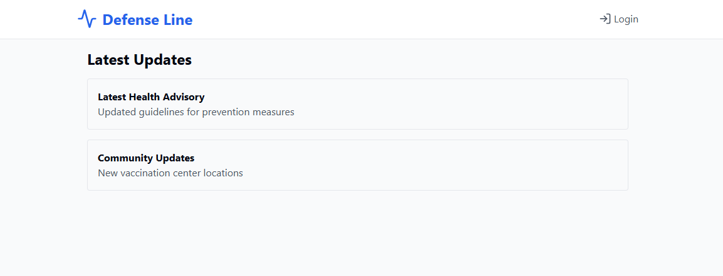

Slide 8
How does News help?
Raising Awareness
Promoting Preventive Measures
Combating Misinformation
Encouraging Compliance with Public Health Directives
Reducing Panic and Stigma

Slide 9
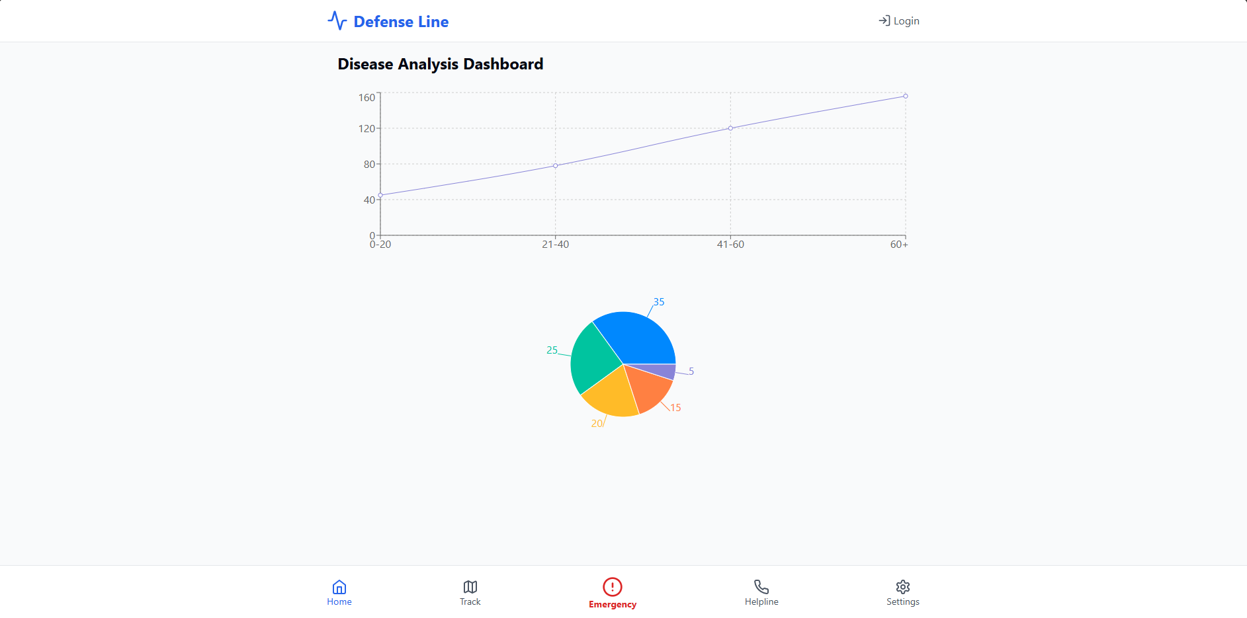

Slide 10
Is that all?
With more time there are many features that could be added to this app.
When the emergency button is pressed, an SMS is sent to nearby health authorities.
With funding Satellite communication can be set up.
A functioning tracking system to show nearby health centres and infected areas.
Your contacts are notified about your health.

